Slide 1
INFO 250 Information Visualization
7B Quick Overview of Weeks 8-10
Dimension Reduction
PCA, tSNE, UMAP

Slide 2
Week | A: Theoretical | B: Practical | Tools
7 | Gestalt | Dimension Reduction | PCA, tSNE, UMPA
8 | Color | Interactive Dashboard | Shiny
9 | Network | Spring Embedding, Sankey, Chord | D3
10 | Demo | Demo

Slide 3
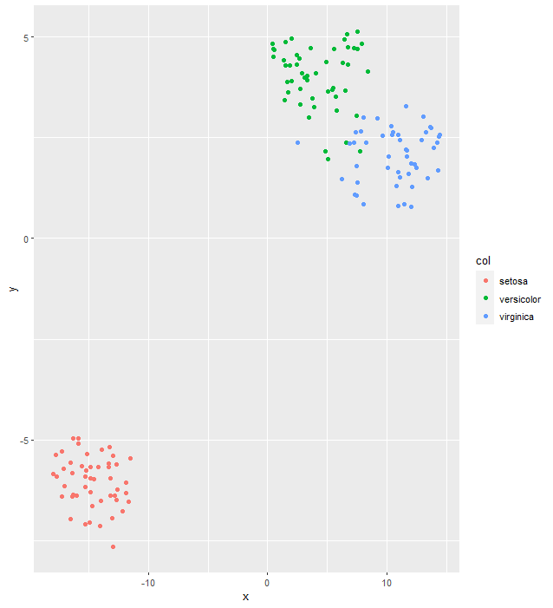
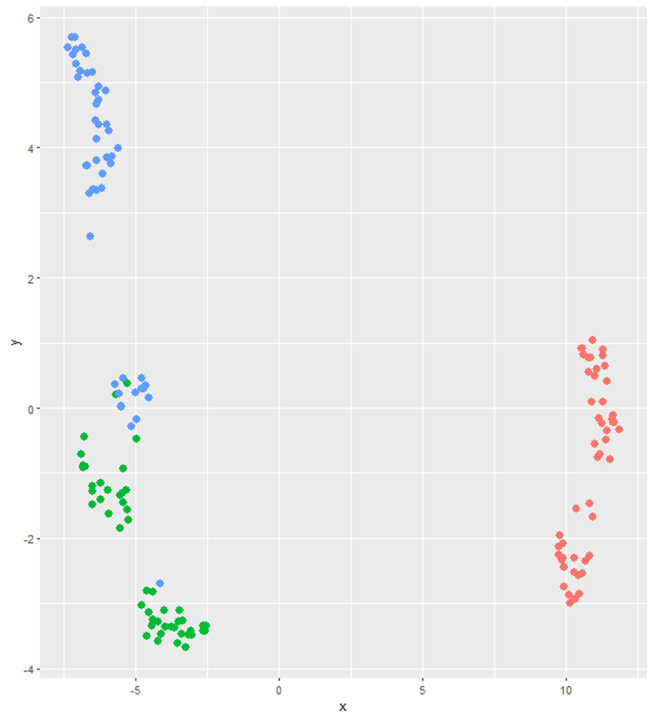
t-SNE
x y Sepal.Length Sepal.Width Petal.Length Petal.Width Species
1 13.99655 2.924492 5.1 3.5 1.4 0.2 setosa
2 12.33640 3.584819 4.9 3.0 1.4 0.2 setosa
3 12.29551 4.115737 4.7 3.2 1.3 0.2 setosa
4 12.54009 4.168110 4.6 3.1 1.5 0.2 setosa
5 14.27660 3.133241 5.0 3.6 1.4 0.2 setosa
6 14.90303 2.328493 5.4 3.9 1.7 0.4 setosa
UMAP

Slide 4
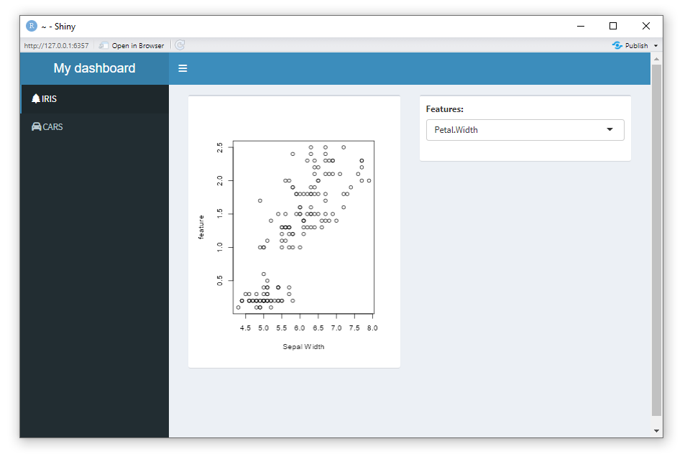

Slide 5
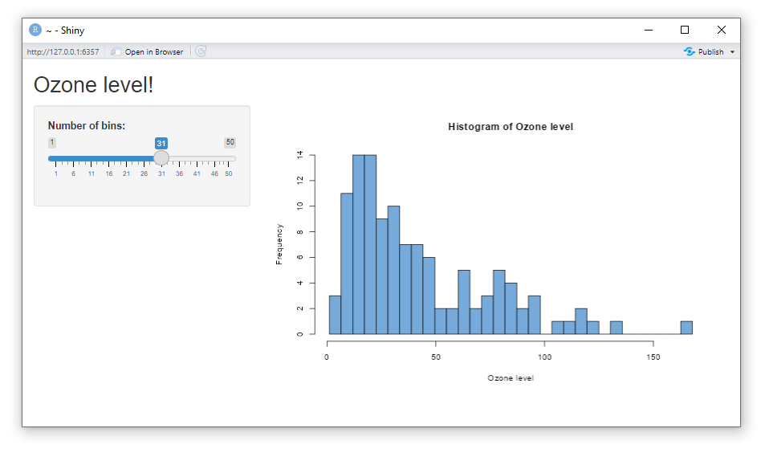

Slide 6
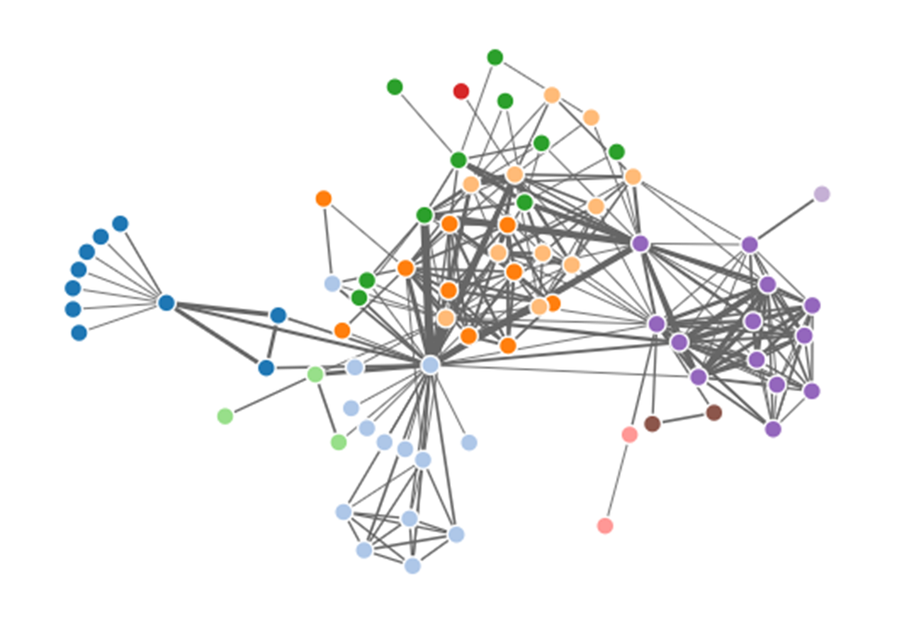
Networks: Spring Embedder

Slide 7
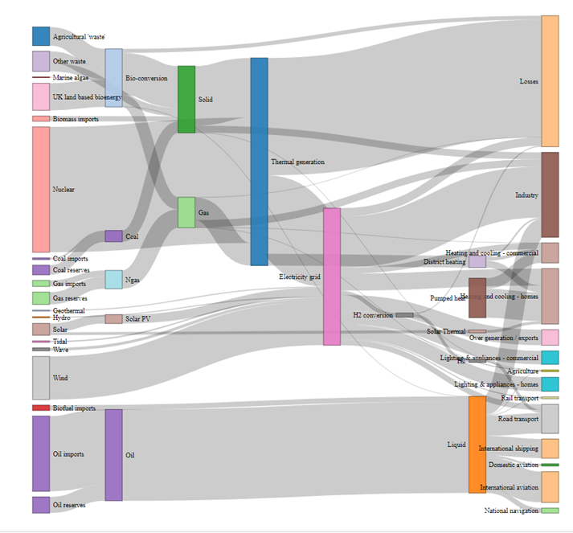
Networks: Sankey

Slide 8
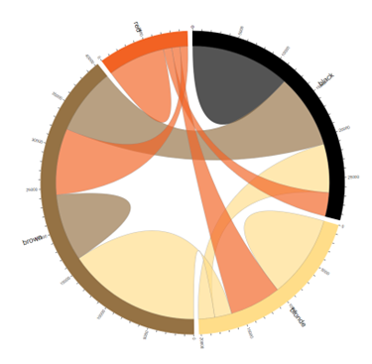
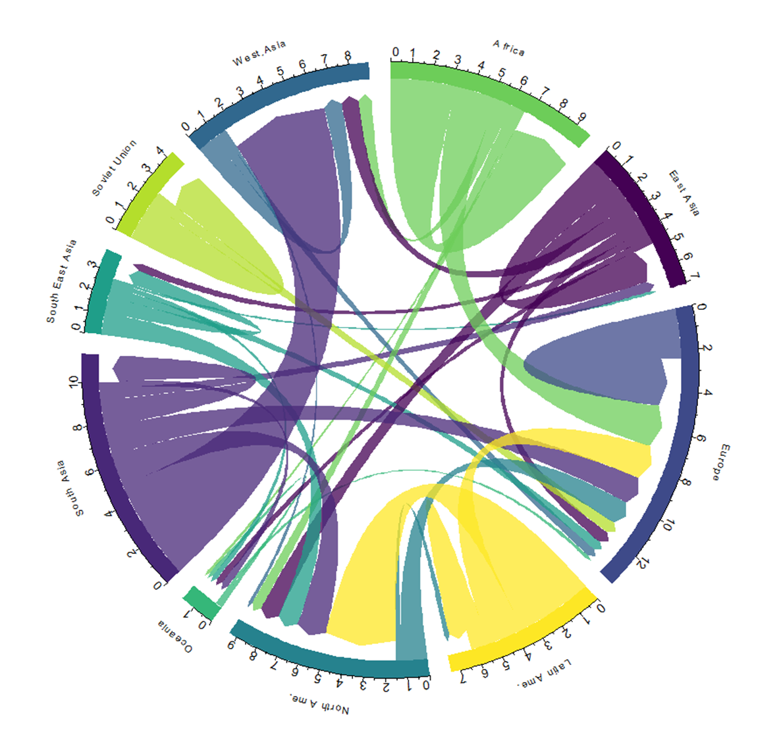
Networks: Chord

